Slide 1

MATHS For ML &DL

Slide 2
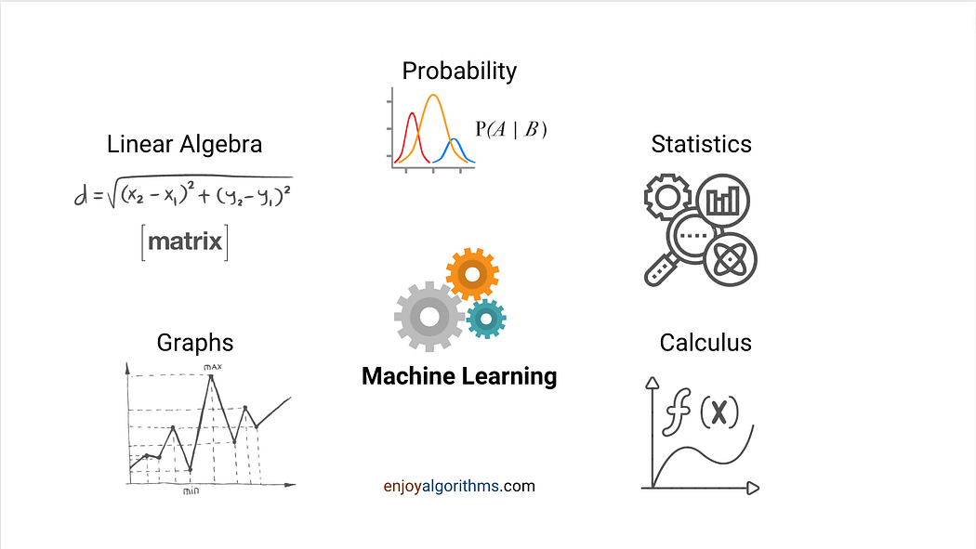

Slide 3
Topics
Statistics and probability
Linear algebra and Matrix
Basic of Calculus
The Math Behind Machine Learning

Slide 4
statistics And Probability
What is statistics
usecase
types of statistics
- descriptive stats
- inferential stats
What is Data
types of Data
measurement of data
descriptive stats
measure of central tendency(mean, median,mode)
measure of Spread(variance,std div, range,percentile,IQR)
measure of Assosiations(covariance, correlations
Measure of symmetricity (Skewness, kurtosis) (optional)
basic of Probability
what is Probapility(key terms , experiment,sample space, event,principal of Prob
Conditional Probability
Bayes Theorm (Naive/Gaussian bayes)
Distributions
Random variables(Discrete, Continous)
distributions functions (optional )
types of Distributions
Inferentical
population/ sample
sampling techniques
Normal/ standard normal Distributions
Central Limit Therom
Hypothesis testing
terms
null, alternate H, level of significane
confidence Interval
Types of Testing

Slide 5
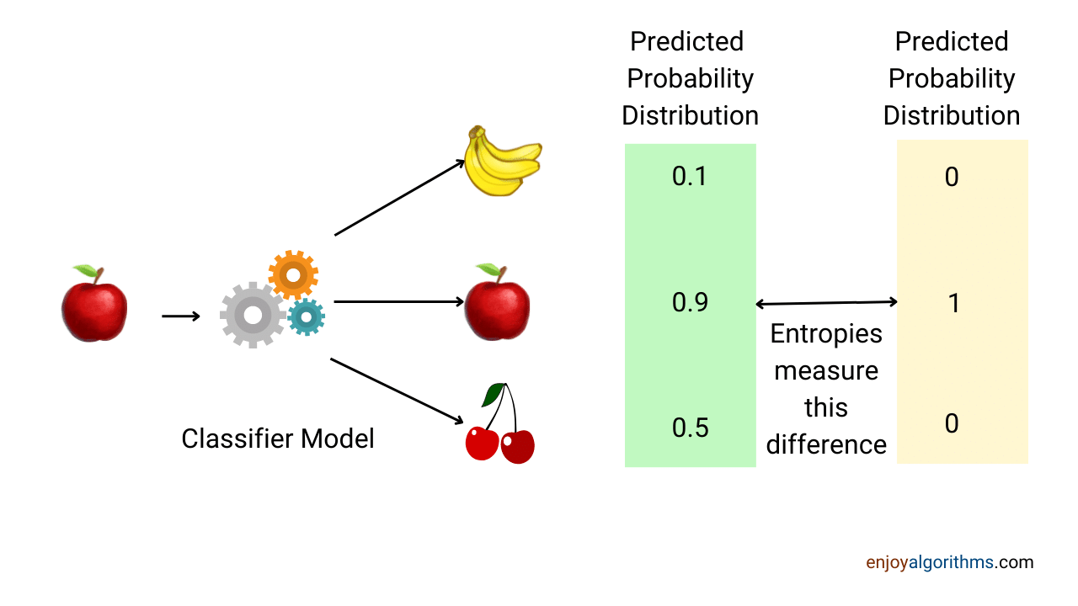

Slide 6
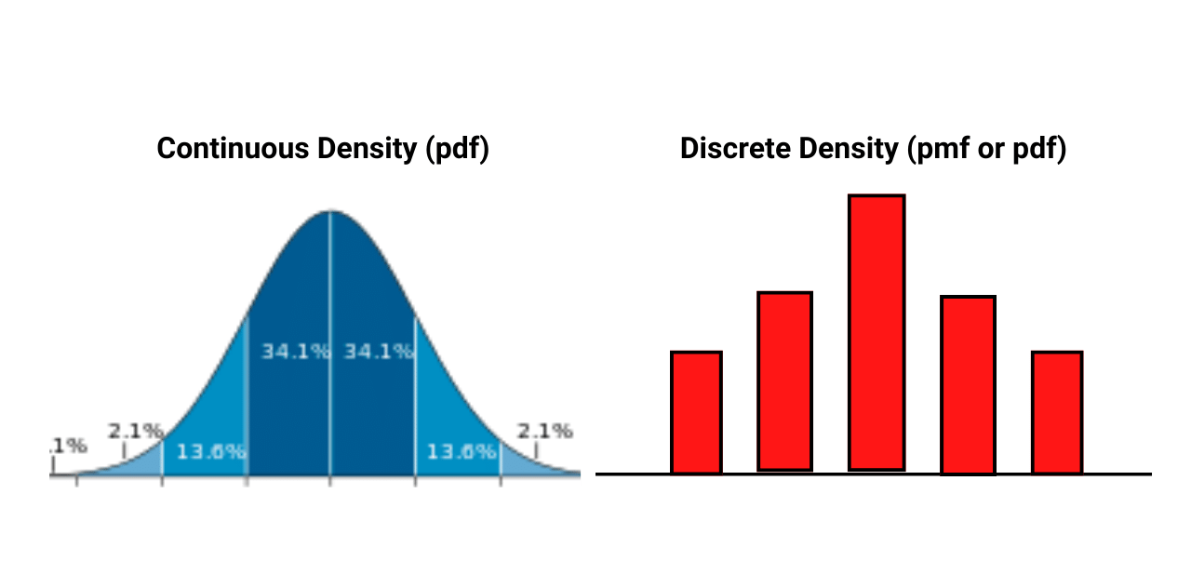

Slide 7
Linear Algebra & Matrix
Line Equations and Slop
Linear Algebra Terms
Vectors & Matrices
Quantities /scaler
Vectors
Vector addition, subtraction, and scalar multiplication
Vector norms and inner products
Matrices
Transpose Matrix
Inverse Matrix
Determinant Matrix
Dot Product
Linear Equations
Eigenvalues and Eigenvectors
Eigenvalue decomposition (EVD)
Singular Value decomposition (SVD) applications
Principal Component Analysis (PCA) /dimensionality reduction
The emphasis of Linear Algebra is on computation. It is utilized for Deep Learning and plays an important part in comprehending the background theory of Machine Learning
It offers us a better understanding of how
algorithms function in real life and allows us to make better judgments
https://www.irjmets.com/uploadedfiles/paper/issue_4_april_2022/21435/final/fin_irjmets1652378206.pdf

Slide 8
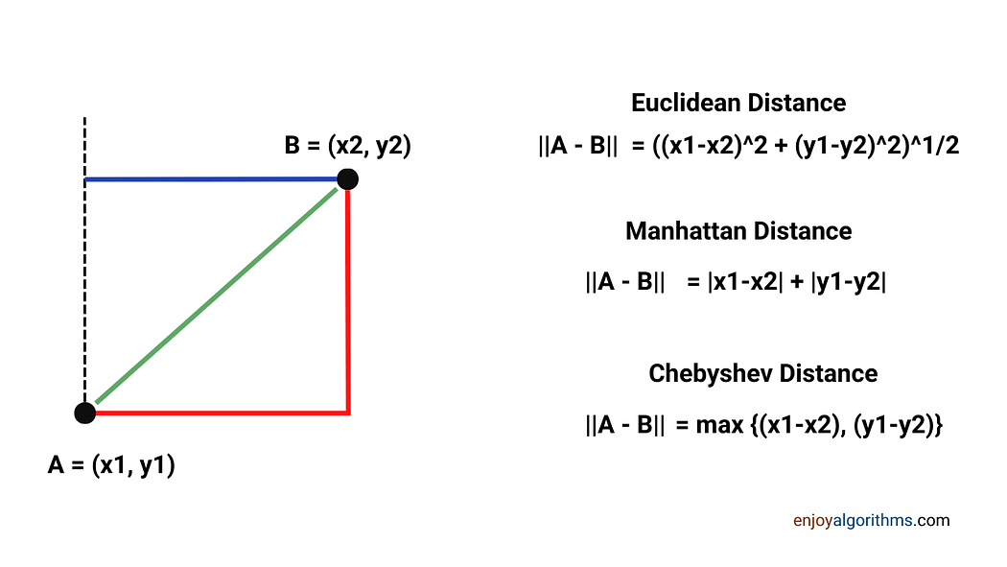

Slide 9
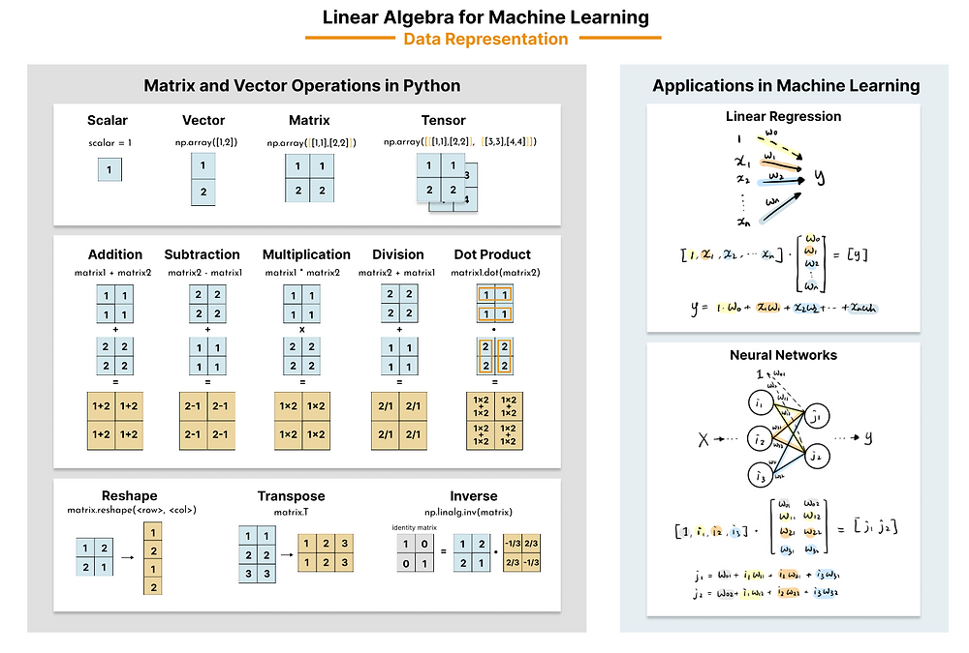
https://datahacker.rs/linear-algebra-for-machine-learning/

Slide 10
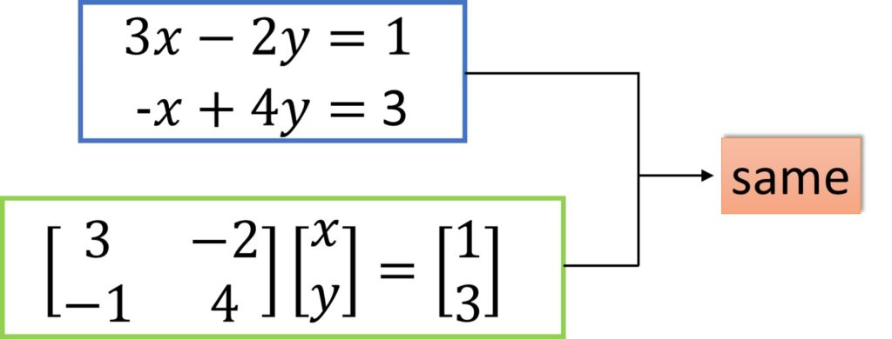
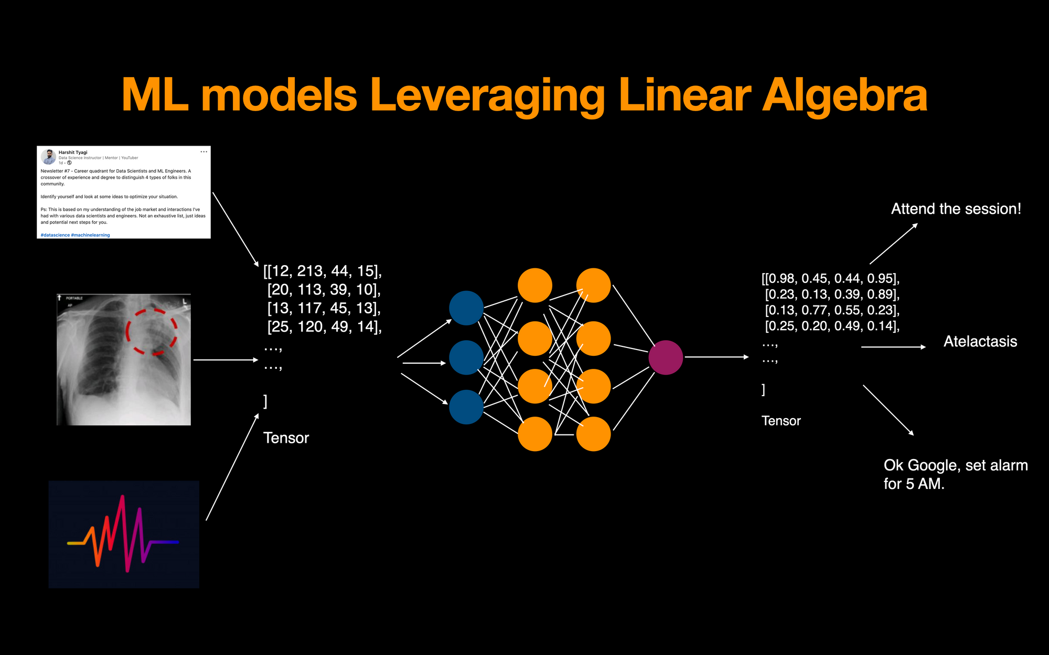
https://setosa.io/ev/image-kernels/

Slide 11
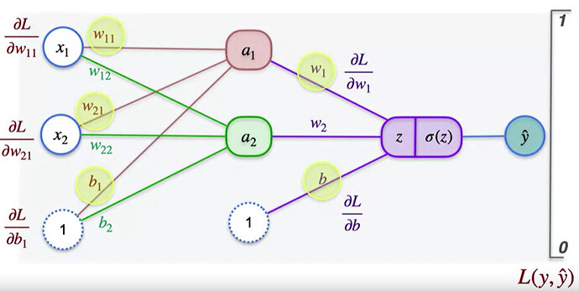
Calculus (ML/Deep Learning)
Basic of Limits and Continuity
Differentiation
Definition of Derivative
Rules of Differentiation (Product Rule, Quotient Rule, Chain Rule)
Applications of Differentiation (Optimization, Rates of Change)
Higher Order Derivatives
Implicit Differentiation
Finding Maxima and Minima
Partial Derivatives(Optionals)
Applications
Derivatives
https://playground.tensorflow.org/
https://adamharley.com/nn_vis/cnn/2d.html
This is a field of mathematics that aids in the study of quantity change rates. It is concerned with improving the performance of machine learning algorithms or models
https://www.enjoyalgorithms.com/tags/machine-learning-concepts/
https://pianalytix.com/calculus-basics-for-machine-learning/
https://github.com/komal-SkyNET/ai-neural-networks/tree/master/gradient-visualization
https://a.co/d/76V5FWg book

Slide 12
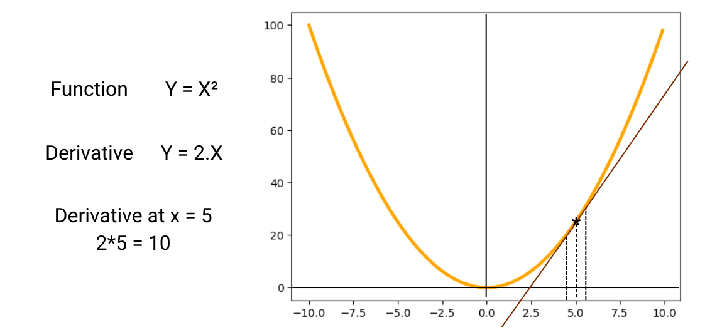
https://community.deeplearning.ai/t/parameters-in-neural-network/700293
https://www.enjoyalgorithms.com/blog/chain-rule-of-calculus-for-neural-networks

Slide 13
statistics And Probability
What is statistics
usecase
types of statistics
- descriptive stats
- inferential stats
What is Data
types of Data
measurement of data
descriptive stats
measure of central tendency(mean, median,mode)
https://www.graphpad.com/support/faq/what-is-the-difference-between-ordinal-interval-and-ratio-variables-why-should-i-care
https://www.toppr.com/guides/maths/statistics/data/

Slide 14
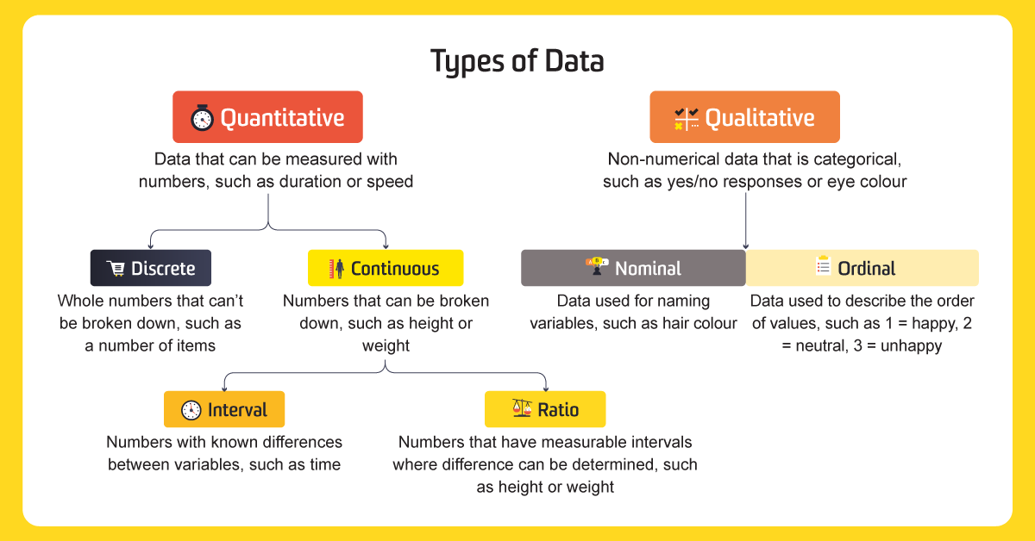

Slide 16
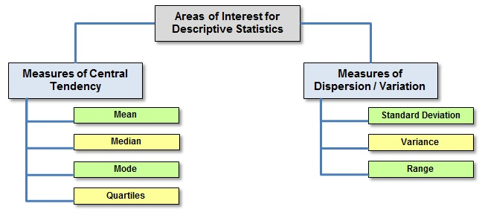

Slide 17
Mean, Median, Mode
https://www.mathsisfun.com/data/central-measures.html
https://www.mathsisfun.com/mean.html
https://www.mathsisfun.com/median.html
https://www.mathsisfun.com/mode.html

Slide 18
https://www.mathsisfun.com/gradient.html
https://www.mathsisfun.com/y_intercept.html

Slide 19
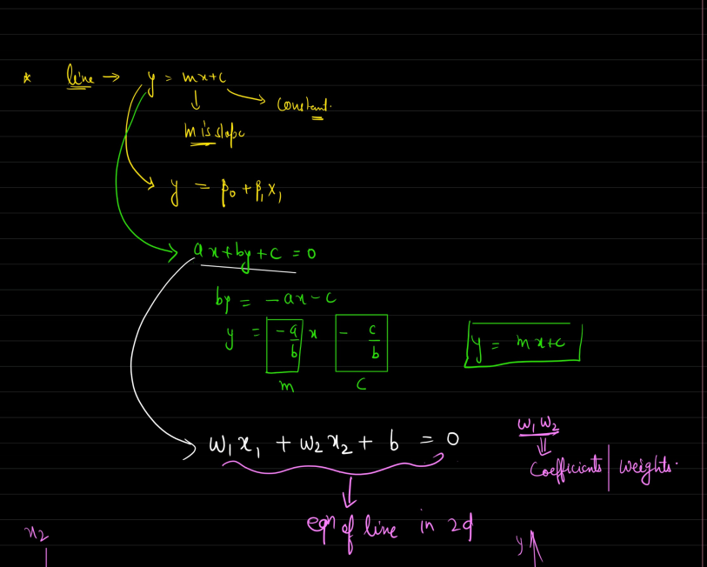
Equations of line
y-=mx+c
slope(gradient), coefficient
intercept
https://www.freecodecamp.org/news/how-machine-learning-leverages-linear-algebra-to-optimize-model-trainingwhy-you-should-learn-the-fundamentals-of-linear-algebra/ usecase ml

Slide 20
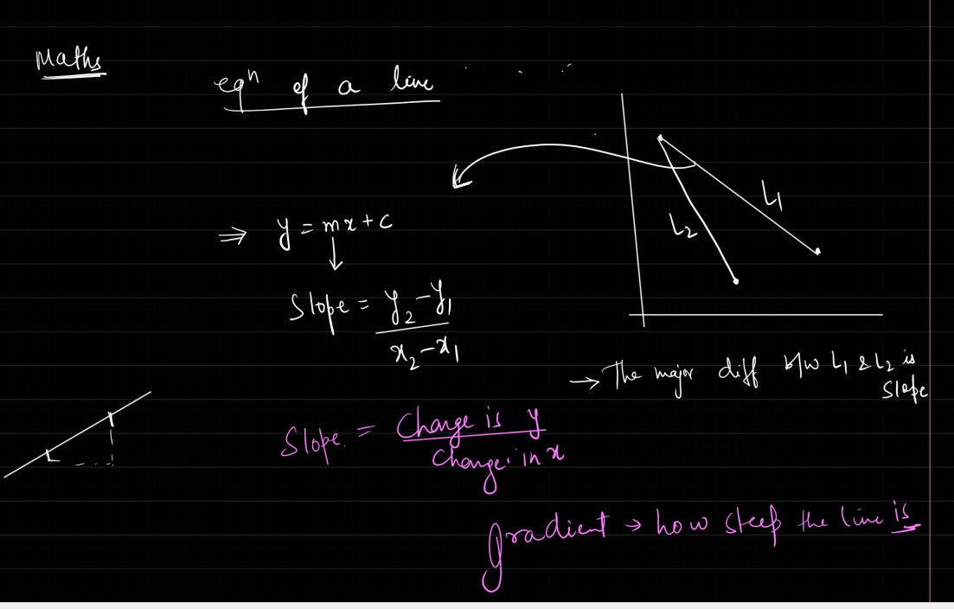
https://www.analyticsvidhya.com/blog/2022/06/linear-algebra-for-data-science-with-python/

